Slide 1
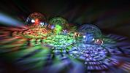
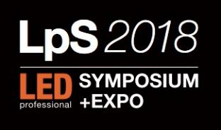
Sustainable Eye Health: ‘a safer light’
8th International
LED professional Symposium +Expo
Sept 25-27, 2018 | Bregenz
Tunable LED Lighting and the retinal dopamine response: a remedy for myopia
Dr Stephen A. Mason B Optom FAAO Dip.OT.
Sustainable Eye Health Pty Ltd
http://www.lightsafe.com.au

Slide 2

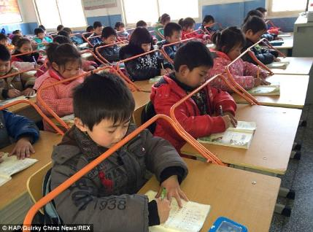
Historical approaches to slowing myopia
Sustainable Eye Health: ‘a safer light’
Cohen (1892): Near work and reading historically linked to being near-sighted
Juler (1904), a renowned British eye surgeon, wrote in A Handbook of Ophthalmic Science and Practice that when “the myopia had become stationary, change of air — a sea voyage if possible — should be prescribed”.
Mutti et al (2002). “Heredity was the most important factor associated with juvenile myopia, with smaller independent contributions from more:
  near work
  higher school achievement
  and less time in sports activity”.
Mountjoy (2018): Using sophisticated DNA analysis over 67,000 subjects in the UK, revealed that time spent in schooling is strongly associated with development of myopia.

Slide 3
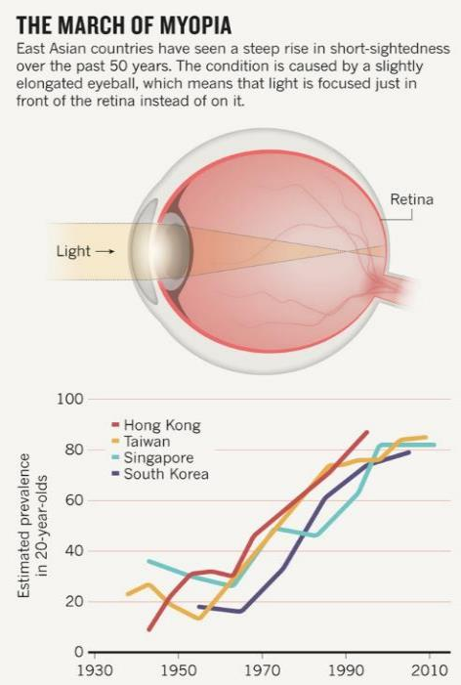
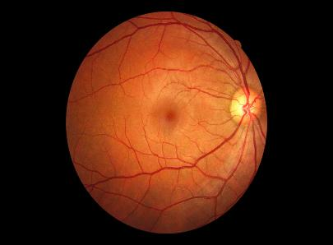
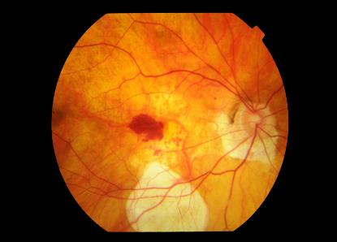
*The Myopia Boom
*By 2050 half the world’s population will be myopic.
Sustainable Eye Health: ‘a safer light’
The posterior pole of a healthy eye viewed through the pupil
The retina of high myopia with a large macular haemorrhage causing permanent loss of central vision
On the math, by 2050 globally, 490 million are at risk of severe vision loss in later life.(Holden B. et al (2015)) .

Slide 4
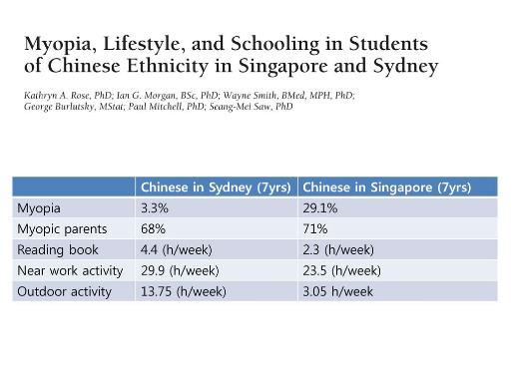
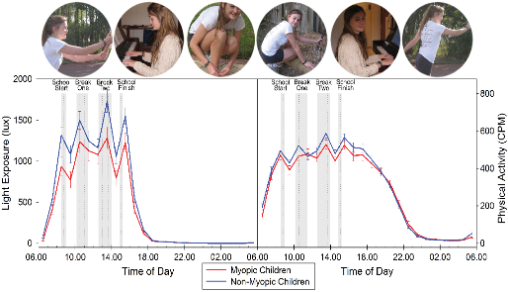
The key to preventing myopia is to be found in SUNLIGHT. Increased ambient light exposure protects against myopia. Rose K. (2008) and Read S. (2014 and 2015) showed respectively:
Sustainable Eye Health: ‘a safer light’
Consistent exposure to sunlight of 2 hours or more per day was associated with less incidence of myopia (Rose and Morgan).
Increased ambient light exposure was associated with i) less frequency of myopia and ii) less progression in eye-growth (Read et al).

Slide 5
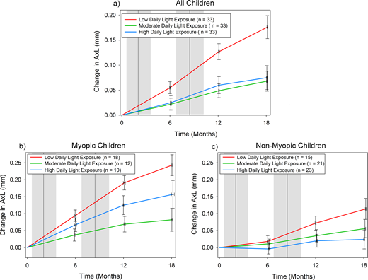
Indoor ambient light has application:
Sustainable Eye Health: ‘a safer light’
Read et al (2015) measured ambient light exposure with wrist-worn sensors (not relying on questionnaires).
His data revealed: “Categorized according to their objectively measured average daily light exposure and adjusting for potential confounders (age, sex, baseline axial length, parental myopia, near-work, and physical activity), children experiencing low average daily light exposure (mean daily light exposure: 459+/-117 lux, annual eye growth: 0.13 mm/y) exhibited significantly greater eye growth than children experiencing moderate (842+/-109 lux, 0.060 mm/y), and high (1455+/- 317 lux, 0.065 mm/y) average daily light exposure levels (P= 0.01).”
The evidence suggests a greater light volume beyond a threshold value may not necessarily yield less eye growth.

Slide 6
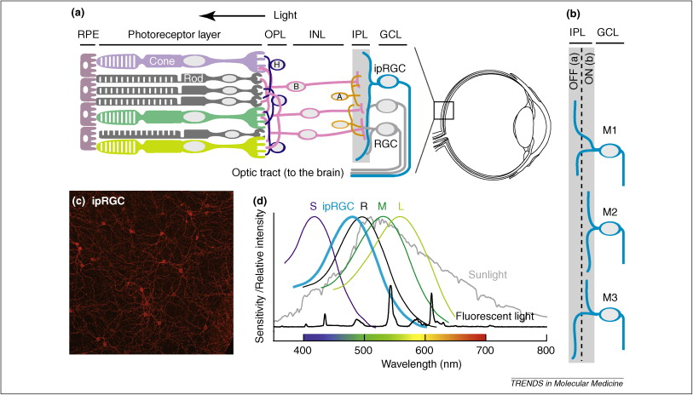

ipRGC’s entrain circadian rhythm and regulation of eye-growth
Sustainable Eye Health: ‘a safer light’
ipRGC’s located within the innermost retinal layers trigger release of dopamine maximally at @480nm that helps the eye self regulate its growth and entrains the circadian rhythm
The retinal dopamine response triggered by ipRGC’s and released by amacrine cells to which they synapse, is a strong local control mechanism that regulates eye- growth
The ipRGC’s dual function: to signal to amacrine cells to control retinal dopamine and to signal the supra-chiasmic nucleus (SCN) as the primary zeitgeber for entrainment of the circadian rhythm
*see: Stone (1989), Czeisler (1995), Bersen et al (2002)
Healthy circadian clock=healthy vision

Slide 7
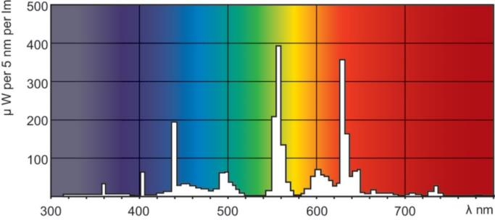

Hua’s intervention study in China showed increasing the illumination in classrooms reduced significantly the frequency of myopia.
Sustainable Eye Health: ‘a safer light’
Hua et al increased the illumination in classrooms using Philips TL5-28W fluorescent globes and measured the effect on the development of myopia. There were more than 300 school children across 56 classrooms from four school campuses in China aged between 6 and 14 years of age.
Prior to intervention, the average illumination in the classrooms was ~100 Lux at desk height. After intervention, the desk illumination was ~500 Lux. After one year, the frequency of myopia in the control arm (no change in illumination) was 10 percent. In the intervention arm (increased illumination), the frequency of myopia was 4 percent.
Increasing the available light at desk height from 100 Lux to 500 Lux had the effect of reducing the incidence of myopia by more than one half.
Spectral Power Distribution of Philips TL5-28W fluorescent globes
*Hua W J, Jin J X, Wu X Y, Yang J W, Jiang X, Gao G P and Tao F B. Elevated light levels in schools have a protective effect on myopia. Ophthalmic Physiol Opt 2015; 35: 252–262

Slide 8
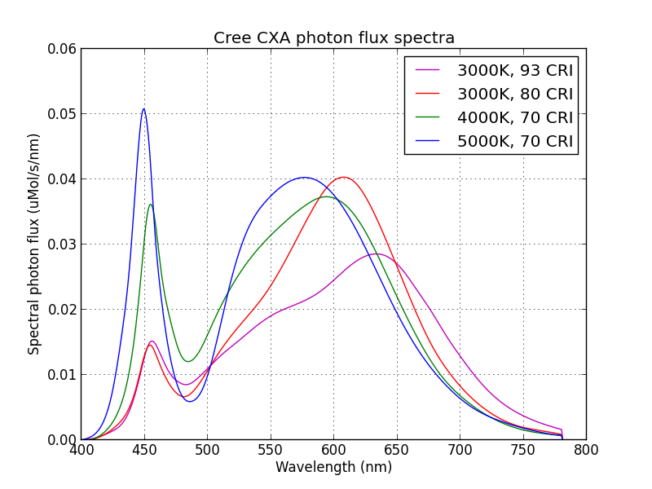
LED modules emit blue light maximally @ 450nm and a trough @480nm
Sustainable Eye Health: ‘a safer light’
*Sunlight and Age-Related Macular Degeneration, The Beaver Dam Eye Study (1993); Archives of Ophthalmology, 111(4):514-8 Klein R.
*The Grading and Prevalence of Macular Degeneration in Chesapeake Bay Watermen (1989), Archives of Ophthalmology, 107(6):847-52, Bressler, N. et al.

Slide 9
Vision researchers revealed risks from exposure to short wavelength (LED) blue light.
Sustainable Eye Health: ‘a safer light’
In 2013, Arnault et al at UPMC (Paris) showed: “blue wavelengths from sunlight of 415-455nm were the most damaging for the retina”.
In 2014, Shang et al: “Our results raise questions about adverse effects on the retina from chronic exposure to LED light [~700 Lux] compared with other light sources that have less blue light. Thus, we suggest a precautionary approach with regard to the use of blue-rich “white” LEDs for general lighting”.
In 2016, Krigel et al : “The data suggest that the blue component of the white-LED may cause retinal toxicity at occupational domestic illuminance and not only in extreme experimental conditions, as previously reported. It is important to note that the current regulations and standards have been established on the basis of acute light exposure and do not take into account the effects of repeated exposure.”
In 2017, Jaadane et al concluded: “These data confirmed the degeneration induced by LED light on the retina, indicating a structural loss of photoreceptors and the activation of two cell death pathways: apoptosis and necrosis.” [Blue LEDs @ 449-473nm/ 100-650 Lux]

Slide 10
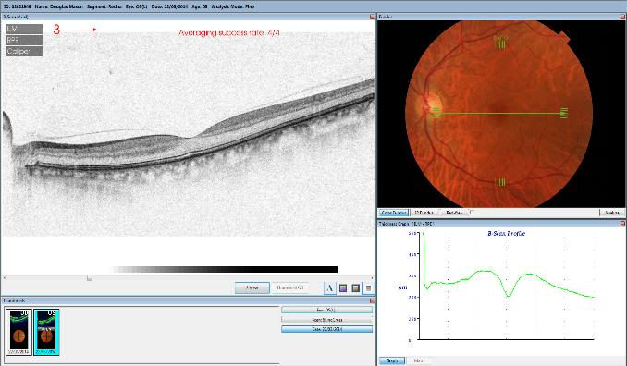
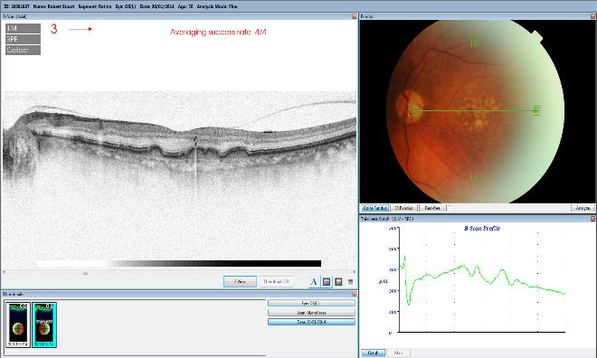
Macular degeneration: the potential risk of long term exposure to 415-455nm (the ‘blue-light-hazard’)
Sustainable Eye Health: ‘a safer light’
OCT/ healthy retina and macular:
OCT/ macular degeneration:

Slide 11
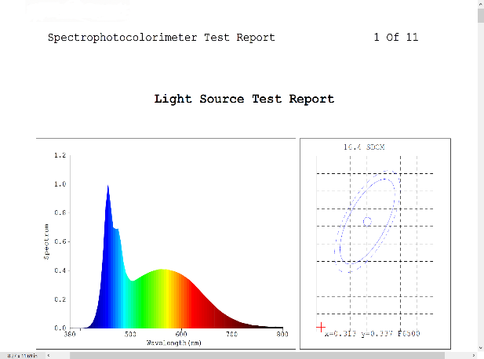
An ophthalmically safe white light that maximally triggers the ipRGC/retinal dopamine and ipRGC/hypothalamic pathways.
Sustainable Eye Health: ‘a safer light’
Sample SPD for tunable light source:
Laboratory Test Luminaire

Slide 12
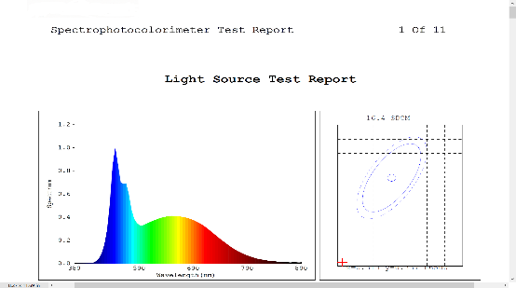
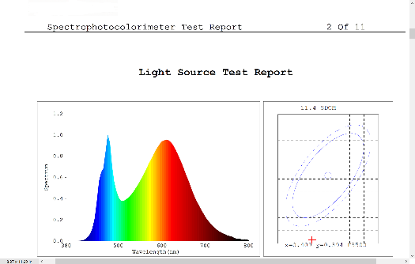
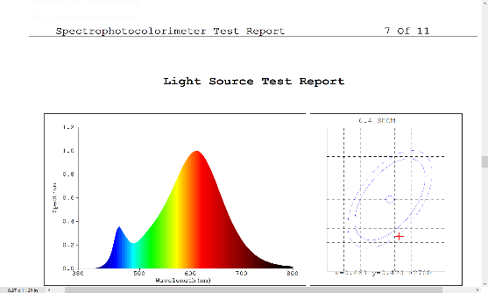
The ‘school light algorithm’: applicable anywhere
Sustainable Eye Health: ‘a safer light’
Fig 1: SPD 9.00-11.00am/ *600Lux @ desk height
Fig 2. SPD 11.00am-1.00pm/ *450Lux @ desk height
Fig 3. SPD 1.00pm-4.00pm/ *350Lux @ desk height
*Room illuminance modified subject to cumulative lux-hours/week, visual comfort and surface albedo. In this case, cumulative lux-hours = 15,750/week.

Slide 13

Importantly: both retinal and systemic circadian rhythms be respected
Sustainable Eye Health: ‘a safer light’
Recent research by Kearney (2017) showed a strong association between elevated morning concentrations of serum melatonin in myopic adults compared to non-myopic adults: “This study reports for the first time in humans that myopes exhibit higher serum Melatonin concentrations than non-myopes. This may indicate a role for light exposure and circadian rhythm in the human myopic growth mechanism…. The results of the present study demonstrate that higher serum concentrations of Melatonin, measured in the morning, are associated with myopia in young adults”.
Melatonin and Dopamine are antagonistic: elevated serum melatonin concentrations are possibly linked to inhibition of retinal dopamine activity and therefore disruption of the local dopamine regulation of eye-growth.
Research by Ayaki (2016) showed a significant correlation between poor sleep cycle and high myopia in Japanese subjects.
The work of Kearney and Ayaki point to the importance of supporting both the retinal and systemic circadian cycles.
Kearney S, et al. (2017) Myopes have significantly higher serum melatonin concentrations than non-myopes. Ophthalmic Physiol Opt; 37: 557–567
Ayaki M, et al. (2016) Decreased sleep quality in high myopia children. Scientific Reports. 6:33902. doi:10.1038/srep33902

Slide 14

LED Lighting: a vital step to contribute to eye health and general well-being for at-risk populations
Sustainable Eye Health: ‘a safer light’
LED Lighting offers an attractive solution to influence eye health in a positive way
By virtue of the inherent design advantages, LED luminaires can be tuned to stimulate beneficial neurological events at both a retinal and cerebral level that results in beneficial health outcomes
The eye-care community is calling for a solution
The LED community are positioned to provide a remedy for at-risk populations
In-action will result in 50% of the world’s population myopic by 2050. Of these 4.9 Billion people who are near-sighted, 490 Million are at high risk of serious vision loss in later life

Slide 15
Lessons Learned
Sustainable Eye Health: ‘a safer light’
The incidence of myopia can be positively influenced via the retinal dopamine response using a tunable form of LED lighting
Strategic selection of wavelengths controls eye-growth whilst protecting the retina from over-exposure to short-wavelength-blue light and ..
This solution is designed to synchronise retinal and systemic circadian clocks
Sustainable Eye Health opens the opportunity for LED lighting to improve eye health and overall health and well-being.

Slide 16
Thank you for your kind attention!
Dr Stephen A Mason OD. FAAO http://www.lightsafe.com.au e: stephenmason102@gmail.com
Sustainable Eye Health: ‘a safer light’

Slide 17
Bibliography
Sustainable Eye Health: ‘a safer light’
Arnault E. et al. (2013) Phototoxic Action Spectrum on a Retinal Pigment Epithelium Model of Age-Related Macular Degeneration Exposed to Sunlight Normalized Conditions: PLoS ONE 8(8): e71398. https://doi.org/10.1371/journal.pone.0071398
Ayuko M. et al. (2016) Decreased sleep quality in high myopia children.. Sci. Rep. 6, 33902; doi: 10.1038/srep33902.
Berson DM, Dunn FA, Takao M (February 2002). "Photo-transduction by retinal ganglion cells that set the circadian clock ". Science. 295 (5557):1070–3
Bowling A. Mode of questionnaire administration can have serious effects on data quality. Journal of Public Health, Volume 27, Issue 3, 1 September 2005, Pages 281291, https://doi.org/10.1093/pubmed/fdi031
Czeisler, C.A., et al. (1995) Suppression of melatonin secretion in some blind patients by exposure to bright light. New Eng J Med 332, 6
Holden B. et al. (2015) Global Prevalence of Myopia and High Myopia and Temporal Trends from 2000 through 2050. Ophthalmology, Volume 123 , Issue 5 , 1036 –1042 http://dx.doi.org/10.1016/j.ophtha.2016.01.006
Hua W-J. et al (2015). Elevated light levels in schools have a protective effect on myopia. Ophthalmic Physiol Opt; 35: 252–262. doi: 10.1111/opo.12207. https://www.ncbi.nlm.nih.gov/pubmed/25913873
Jaadane I. et al. (2015) Retinal damage induced by commercial light emitting diodes (LEDs) Free Radical Biology and Medicine 84 373–384
Kearney S. (2017) Myopes have significantly higher serum melatonin concentrations than non-myopes. Ophthalmic Physiol Opt; 2017; 37: 557–567.
Krigel A. et al. (2015) Light-induced retinal damage using different light sources, protocols and rat strains reveals LED phototoxicity. Neuroscience, Elsevier - International Brain Research Organization.
Edward Mountjoy, Neil M Davies, Denis Plotnikov, George Davey Smith, Santiago Rodriguez, Cathy E Williams, Jeremy A Guggenheim, Denize Atan (2018) Education and myopia: assessing the direction of causality by mendelian randomisation
Mutti D. et al (2002) Parental myopia, near work, school achievement, and children's refractive error. Invest Ophthalmol Vis Sci; 43(12):3633-40
Read S. et al. (2014) Light Exposure and physical activity in myopic and emmetropic children. 1040-5488/14/9103-0330/0 VOL. 91, NO. 3, PP. 330-341 Optometry and Vision Science American Academy of Optometry
Read S. et al. (2015) Light exposure and eye growth in childhood. Invest Ophthalmol Vis Sci. 2015;56:6779–6787. DOI:10.1167/iovs.14-15978
Rose K. et al (2008) Myopia, lifestyle, and schooling in students of Chinese ethnicity in Singapore and Sydney Arch Ophthal 2008 Apr;126(4):527-30. doi: 10.1001/archopht.126.4.527
Stone R. et al (1989) Retinal dopamine and form deprivation myopia. Proc. Natl. Acad. Sci. U. S. A: 86, pp. 704-706.

